Slide 1
Presenter: Qiao, Wensong
GR 5243 Applied Data Science
Project 4 OCR (Optical Character Recognition)
Group 9 Team Members:
Karsok,Max
Sun,Shengjie
Zheng,Fei
Zhong,Ming

Slide 2


Outline
s
V
Baseline Model
Advanced Model
Flow chart
Import Data
Preprocess
Detection
Correction
Evaluation

Slide 3

Baseline Model
Error detection
Check whether word exists in ground truth. If any words are not in ground truth, the word is detected as error.
Error correction
Just simply remove the detected-errors
3 | Presentation Title Presentation Title

Slide 4
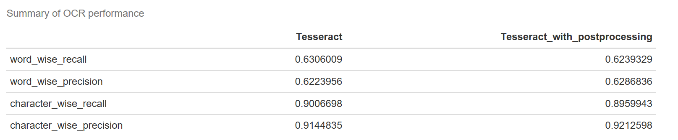
Baseline Model
Result
4 | Presentation Title Presentation Title

Slide 5

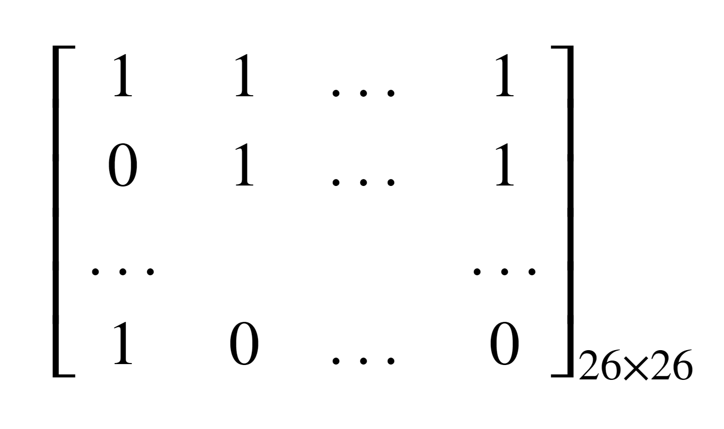


Advanced Model
Error detection
Method: Binary n-Grams Method (D-2)
Idea: Check whether letter pairs in the word at different positions exists in ground truth. If any pairs of letters are not in ground truth, the word is detected as error.
Concept:
a b … z
Binary 2-gram Matrix:
a b … z
n-Grams
A length n word $W$= $l_{1}l_{2}{…l}_{k}$
$D_{ij}$ =
5 | Presentation Title Presentation Title

Slide 6
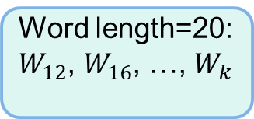
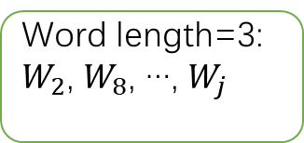
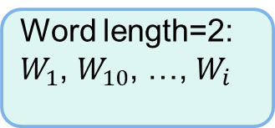
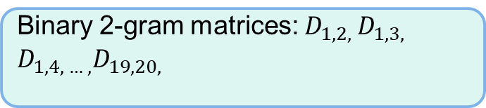
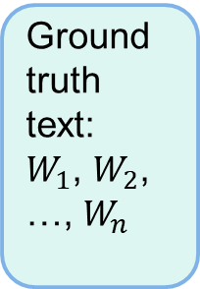
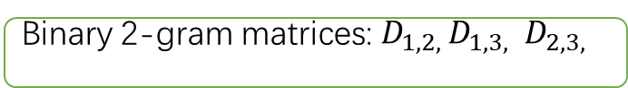
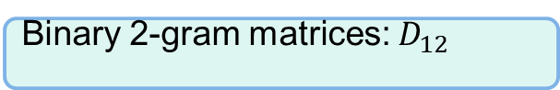
Advanced Model
Binary n-Grams Method (D-2)
How to create all binary 2-gram matrices:
Word length=2:
$W_{1}$, $W_{10}$, …, $W_{i}$
Binary 2-gram matrices: $D_{12}$
Ground truth text:
$W_{1}$, $W_{2}$, …, $W_{n}$
Word length=3:
$W_{2}$, $W_{8}$, …, $W_{j}$
Binary 2-gram matrices: $D_{1,2, }D_{1,3, }$ $D_{2,3, }$
…
Word length=20:
$W_{12}$, $W_{16}$, …, $W_{k}$
Binary 2-gram matrices: $D_{1,2, }D_{1,3, }$ $D_{1,4, … ,}D_{19,20, }$
6 | Presentation Title Presentation Title

Slide 7

Advanced Model
How to detect error
1.Check letter pairs in binary 2-gram matrices of length n, if $D_{i,j}$ is 0 with $P_{i,j}$ pairs, then $D_{i,j}$ detected an error
2. Find union set of the locations where detected the error happened, the result is the error location in the word.
7 | Presentation Title Presentation Title

Slide 8
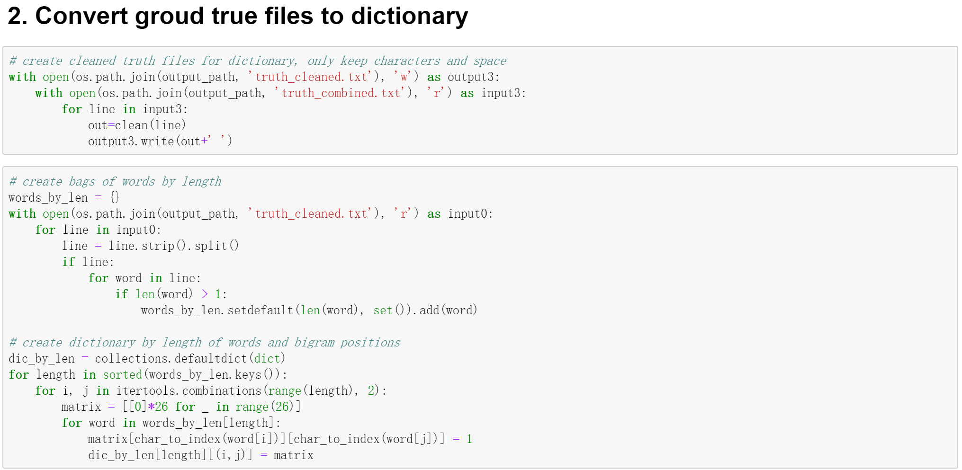
Advanced Model
Step 1
1
8 | Presentation Title Presentation Title

Slide 9
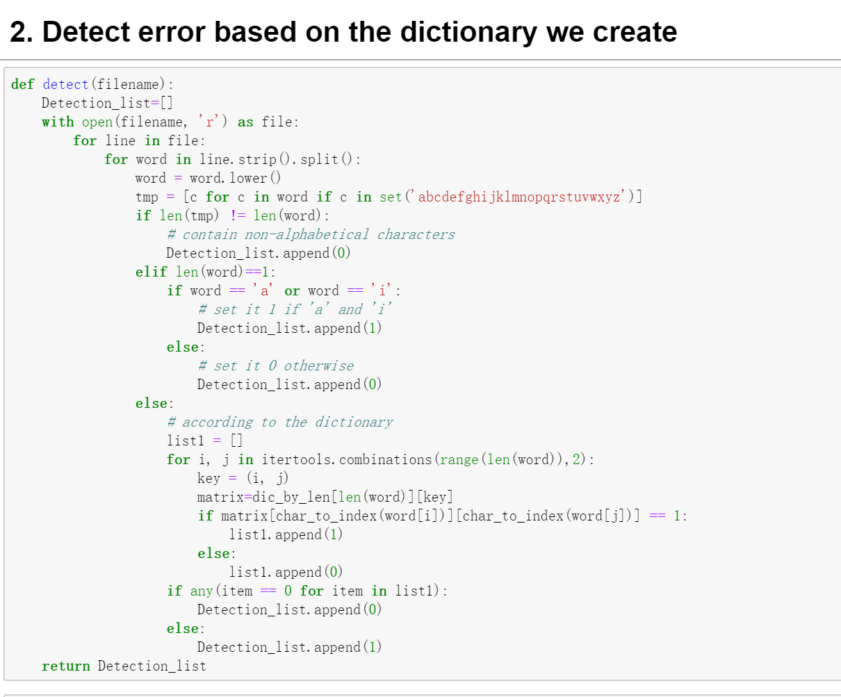
Advanced Model
Step 2
Rules: (0-error;1-good)
- If the word contains non-alphabetical characters, set it 0.
- If the word contains only one character, set it 1 if 'a' and 'i' and 0 otherwise.
- Then set 1 or 0 in other cases according to the dictionary we create.
9 | Presentation Title Presentation Title

Slide 10
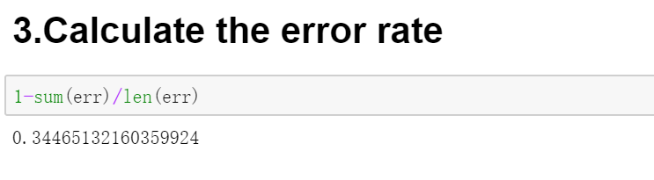
Advanced Model
Result:
10 | Presentation Title Presentation Title

Slide 11

Advanced Model
Error correction
Method: Statistical Learning Model
Idea: Build a regression model with six feature scores to predict what kinds of candidate we should choose to correct error.
Flow:
1. Divided all detected error in 75% and 25% as training set and test set
2. Do AdaBoost regression with weighted loss function
3. Predict label score for candidates in the test set
4.The highest label score candidate will be used to correct error
11 | Presentation Title Presentation Title

Slide 12

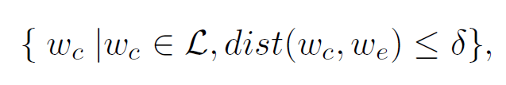
Advanced Model
1.Candidate Search：
Question: How can we know what kind of candidates(word) we should use for correction
Answer: Damerau-Levenshtein distance
e means error, c means candidate. δ is a distance threshold.
We use ground truth as dictionary to choose candidates
12 | Presentation Title Presentation Title

Slide 13
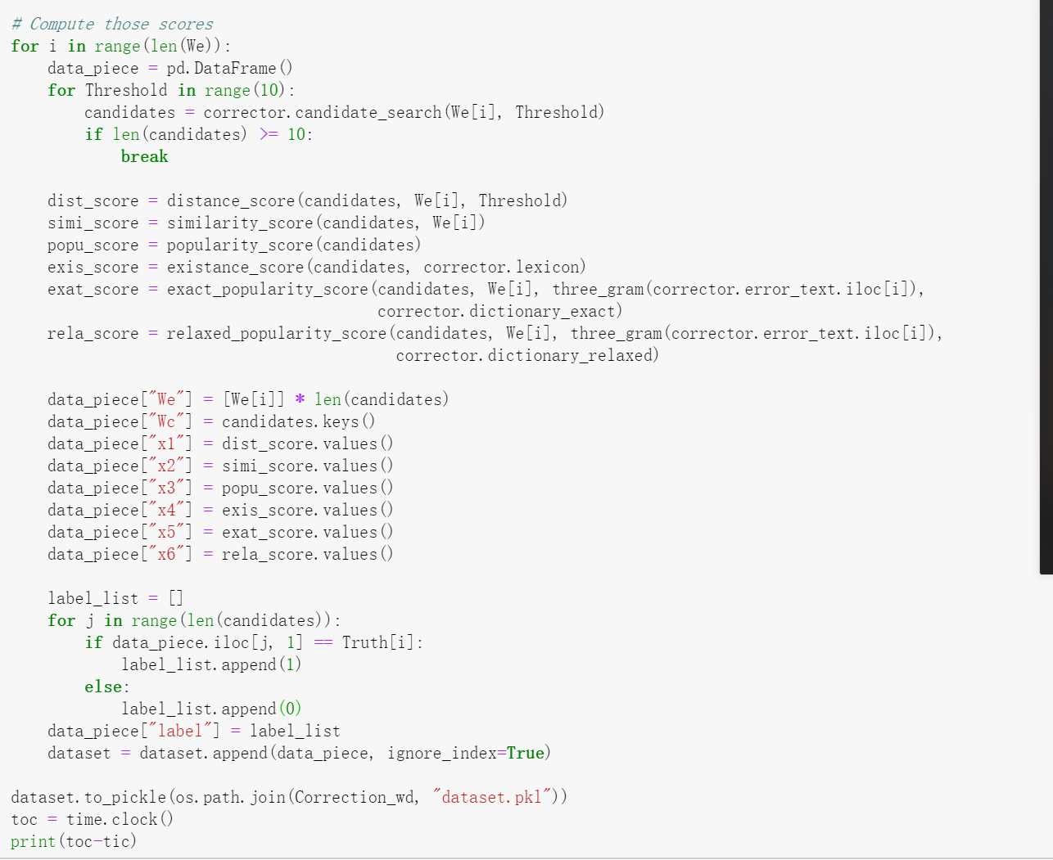
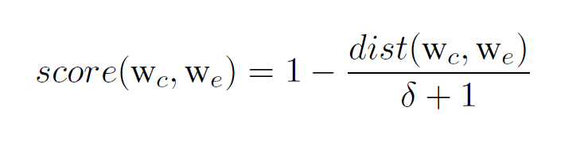
Advanced Model
2.Feature Score：
Idea: the measurement of similarity of different strings.
Types:
— Levenshtein edit distance score
— String similarity score
— Language popularity score
— Lexicon existence
— Exact-context popularity
— Relaxed-context popularity
Example: Levenshtein edit distance score
13 | Presentation Title Presentation Title

Slide 14
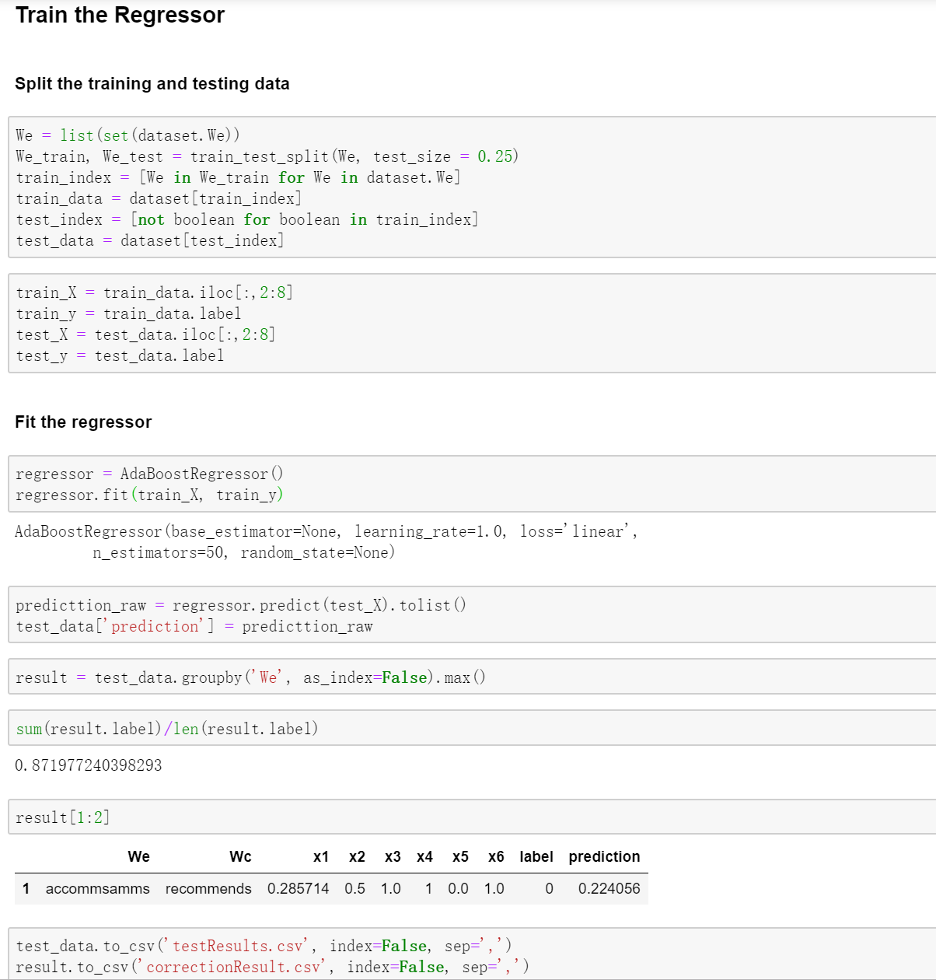
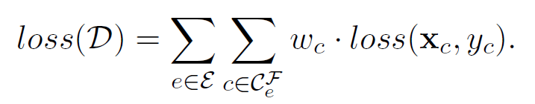
Advanced Model
3. Regression model ：
Model: AdaBoost
Loss Function: weighted loss function (deal with unbalanced label problem)
14 | Presentation Title Presentation Title

Slide 15
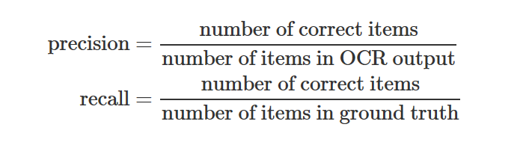
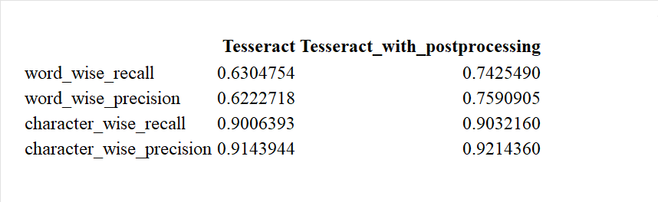
Advanced Model
Evaluation:
Result:
15 | Presentation Title Presentation Title

Slide 16

Thank You!
TRANSCENDING DISCIPLINES, TRANSFORMING LIVES

